Slide 1
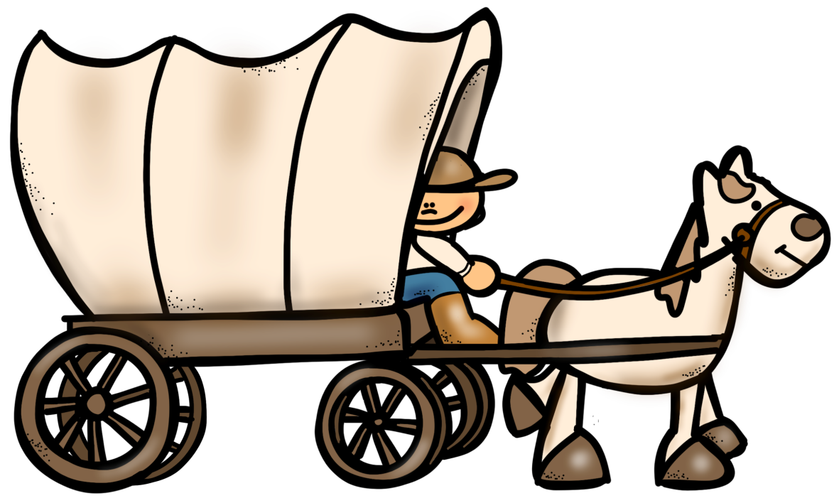
Trail
of
Tears
PowerPoint & Notes
© Erin Kathryn 2015

Slide 2
Indian Removal Act
Each year, settlers moved farther west.
Andrew Jackson, the President of the United States, felt that American Indians hindered the nation’s growth by living on land the settlers wanted.
Congress agreed with President Jackson.
1830 – President Jackson signed the Indian Removal Act.
This law ordered all the Indian nations east of the Mississippi River to move west of that river.
© Erin Kathryn 2015

Slide 3
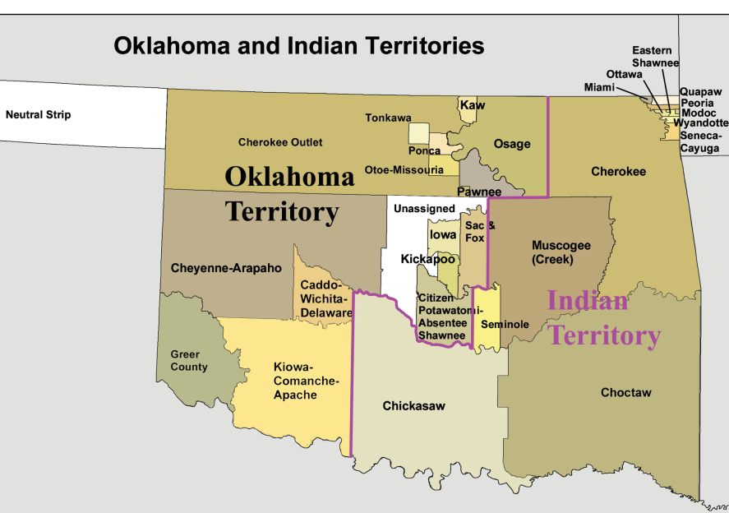
Indian Territory
The United States army forced Choctaw, Creek, and Chickasaw people to move to present day Oklahoma.
This area was named Indian Territory by Congress.
© Erin Kathryn 2015

Slide 4
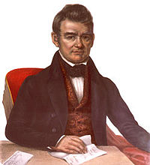
Fighting the
Indian Removal Act
A Cherokee chief, named John Ross, led the fight against the Indian Removal Act.
He went to the Supreme Court.
The head of the Supreme Court, Chief Justice John Marshall, ruled that it was against the law to force the Cherokee to move.
© Erin Kathryn 2015

Slide 5
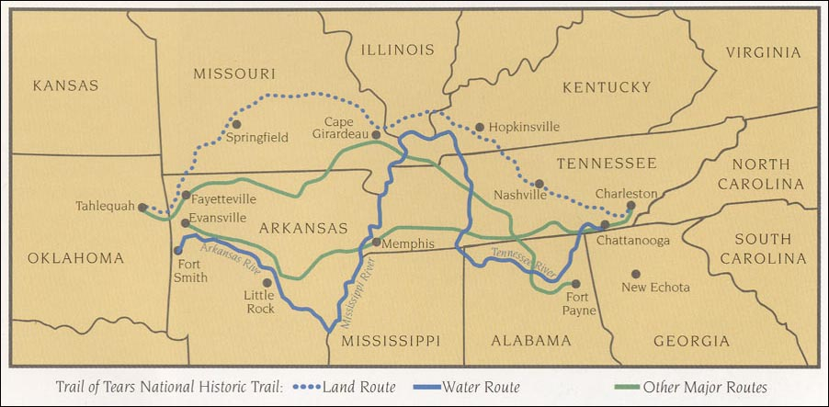
The Trail of Tears
President Jackson ignored the Supreme Court’s rule.
1838 – Cherokee Indians were forced by the United State Army to make the 1,000 mile trip to Indian Territory.
This trip was referred to as the Trail of Tears.
© Erin Kathryn 2015

Slide 6
The Trail of Tears
The Indians had little to eat on their journey.
The weather was cold and disease spread quickly.
Along the way, about one-fourth of the Cherokee Indians died.
© Erin Kathryn 2015

Slide 7
Summary
After Andrew Jackson was elected President, he ordered thousands of American Indians off their land.
American Indians were forced to move west and live in a new environment.
Their difficult journey west was known as the Trail of Tears.
© Erin Kathryn 2015

