Slide 1
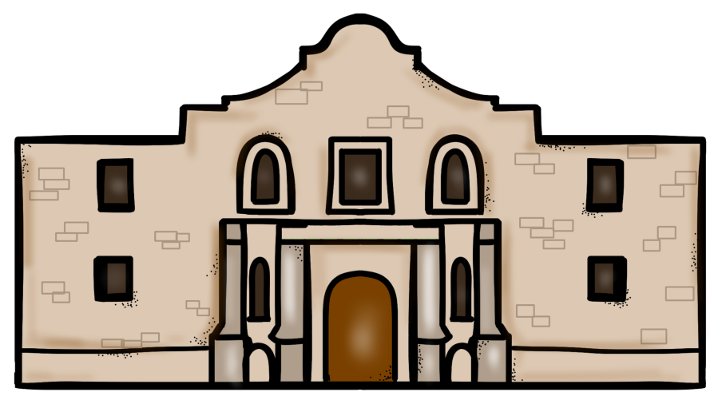
Texas
and the
Mexican
War
PowerPoint & Notes
© Erin Kathryn 2015

Slide 2
Texas
1821 – The first settlers from the United States arrive in Texas looking for inexpensive land.
At this time, Texas was a part of Mexico.
Within ten years, there were more Americans in Texas than Mexicans.
Mexico made laws to stop settled from coming to Texas, but they were unsuccessful.
© Erin Kathryn 2015

Slide 3
Differences
When Americans arrived in Mexico, they were not always willing to obey Mexican laws.
Americans brought slaves to Mexico, even though slavery was illegal in Mexico.
Because of their many differences, the settlers wanted to break away from Mexico.
© Erin Kathryn 2015

Slide 4
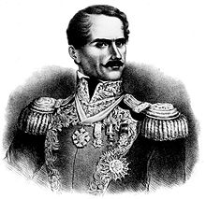
The Fight Begins
Some Mexicans, called Tejanos, wanted to break away from Mexico, too.
They did not like the laws that were made by Antonio Lopez de Santa Anna, the President of Mexico.
Tejanos and Texans rebelled against Mexico in hopes of gaining their independence.
© Erin Kathryn 2015

Slide 5
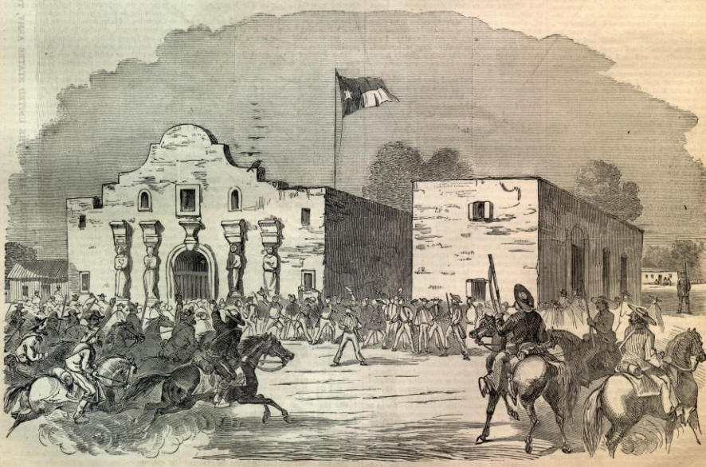
Capture the Alamo
Early 1836 – Santa Anna led a large army to San Antonio to put a stop to the Texan and Tejano rebellion.
His goal was to capture the Alamo, which was an old mission that was used as a military fort.
Less than 200 Texans and Tejanos defended the fort. Most of them were killed during the Battle of the Alamo.
© Erin Kathryn 2015

Slide 6
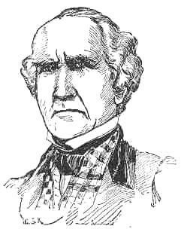
Sam Houston
Texan leaders voted to declare independence from Mexico and form the Republic of Texas.
Sam Houston was chosen to lead the army in the fight against Mexico.
Houston led a surprise attack on Santa Anna’s army at San Jacinto, which lead to the defeat of Mexican troops and capturing of Santa Anna.
In order to gain his freedom, Santa Anna agreed to give Texas its independence.
© Erin Kathryn 2015

Slide 7
Texas Becomes a State
September 1836 – The Republic of Texas held its first election.
Sam Houston was elected president.
Slavery was made legal.
Texas voted to join the United States.
Some were in favor of annexation, or joining, with the United States.
Others, such as Martin Van Buren, the U.S. President, were not.
He feared that Mexico would start a war with the United States because Mexico wanted
Texas back and he did not want to add a new
state that allowed slavery.
© Erin Kathryn 2015

Slide 8
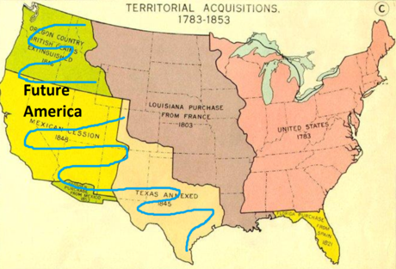
Manifest Destiny
Supporters of annexation argued that it was the nation’s destiny to expand west.
Many believed that the United States should spread across the entire North American continent.
This belief was called manifest destiny.
Supporters of manifest destiny thought that Texas should become part of the United States.
1845 – James Polk became President and Congress voted to annex Texas.
© Erin Kathryn 2015

Slide 9
War with Mexico
President Polk and the Mexican government could not agree on where the border between Texas and Mexico should be, the Nueces River or the Rio Grande.
Polk sent soldiers into Texas and asked Congress to declare war with Mexico.
May 13, 1846 – Congress declared war on Mexico.
© Erin Kathryn 2015

Slide 10
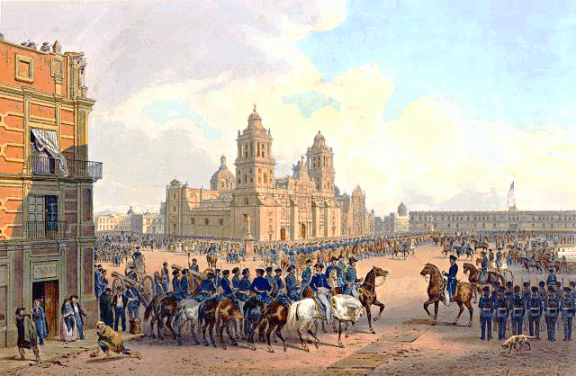
Mexican War
The Mexican War was fought on three fronts, which is where fighting takes place in a war.
First front – northern Mexico
Second front – New Mexico (where solders captured Santa Fe)
Third front – southern Mexico
September 1847 - U.S. soldiers invaded by sea and captured Mexico City.
© Erin Kathryn 2015

Slide 11
Treaty of
Guadalupe Hidalgo
After Mexico City was captured, Mexico’s leaders agreed to sign a peace treaty.
1848 – United States and Mexico signed the Treaty of Guadalupe Hidalgo.
Mexico agreed to the annexation of Texas and set the Rio Grande as the border between Texas and Mexico.
© Erin Kathryn 2015

Slide 12
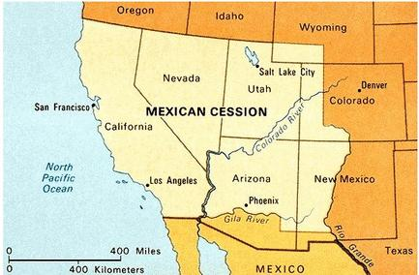
Mexican Cession
Mexico was also forced to give up a large area of land called the Mexican Cession.
The United States paid Mexico $15 million for the cession.
Mexicans living on his land were allowed to become United States citizens.
Laws protected them from losing their land, but many lost their land because these laws were often ignored.
© Erin Kathryn 2015

Slide 13
This is important
because…
Texas, California, and nearly all of the American Southwest became part of the United States after the Mexican War.
© Erin Kathryn 2015

