Slide 1
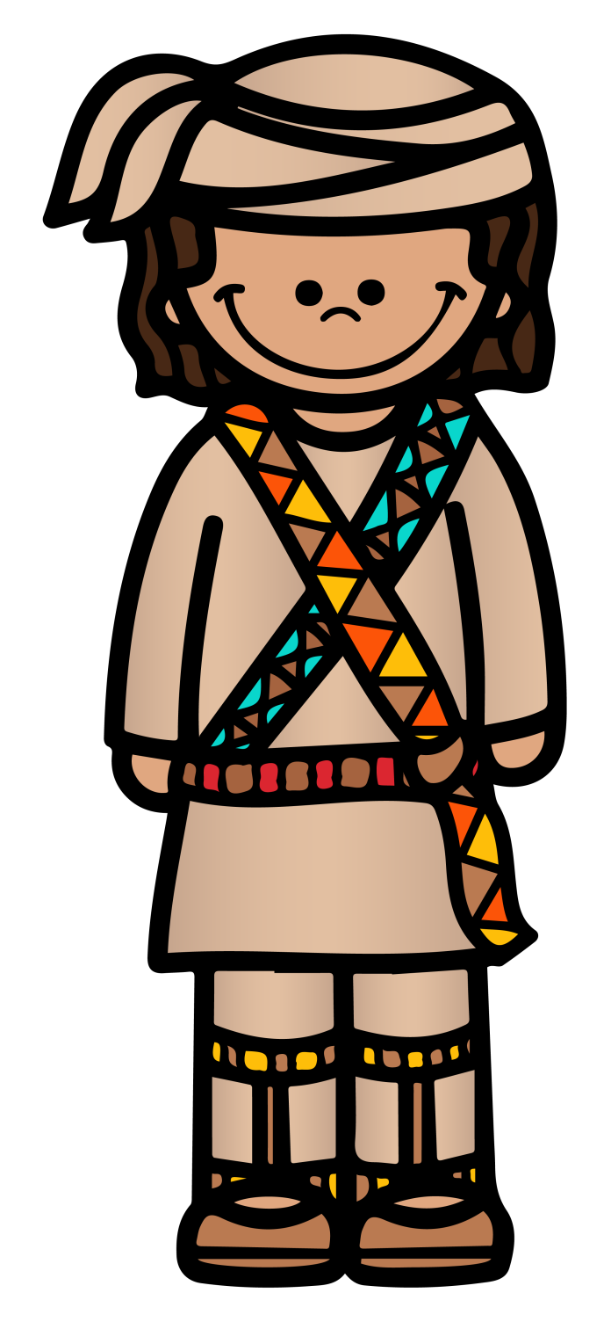
SEMINOLE
tribe
PowerPoint
&
Notes
© Erin Kathryn 2015

Slide 2
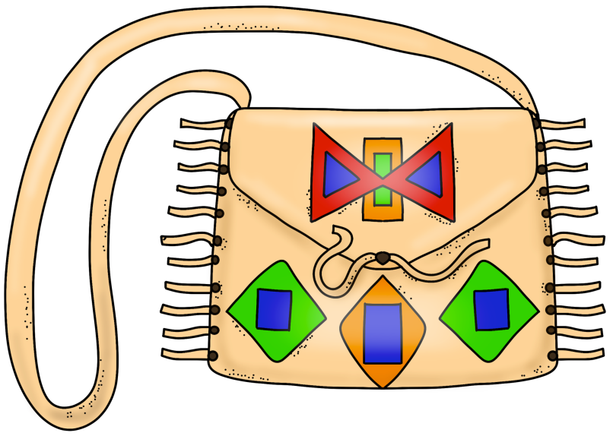
Climate & Region
Southeast
Present-day Florida
Hot and humid weather
© Erin Kathryn 2015

Slide 3
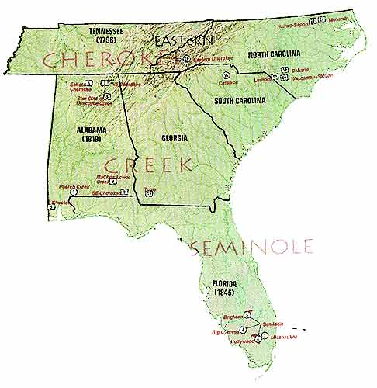
© Erin Kathryn 2015

Slide 4
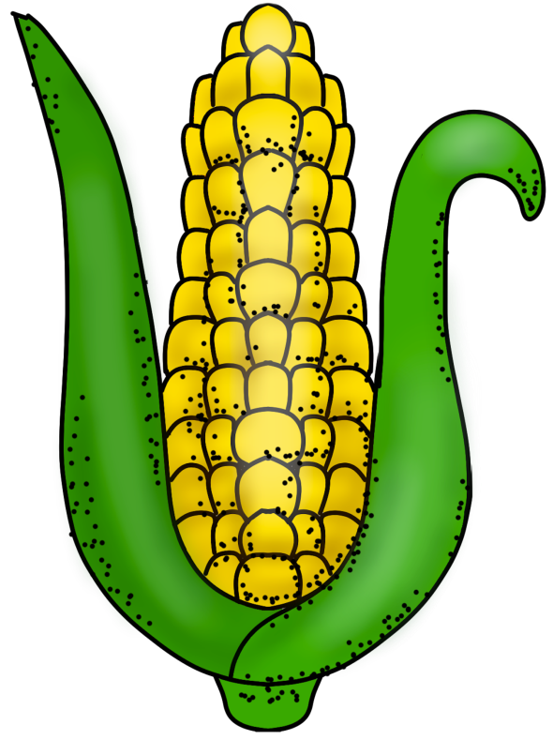
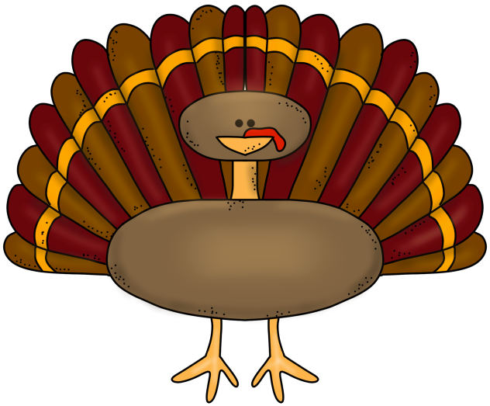
Food
Gathered nuts, berries, and roots
Corn, beans, and squash
Hunted wild game and turkey
© Erin Kathryn 2015

Slide 5
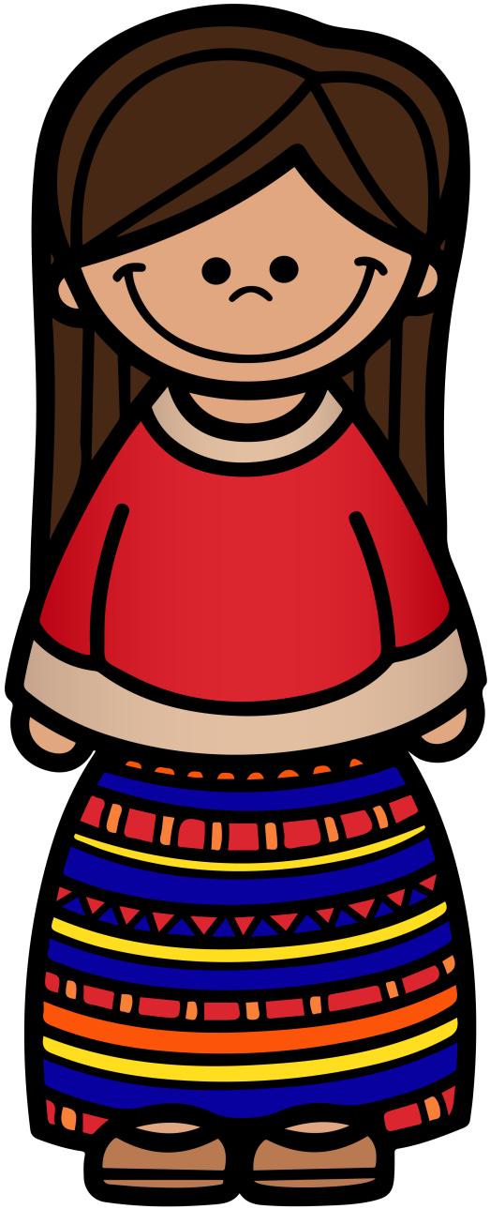
Clothing
Thing clothing made out of grass
Breechcloths and moccasins
© Erin Kathryn 2015

Slide 6
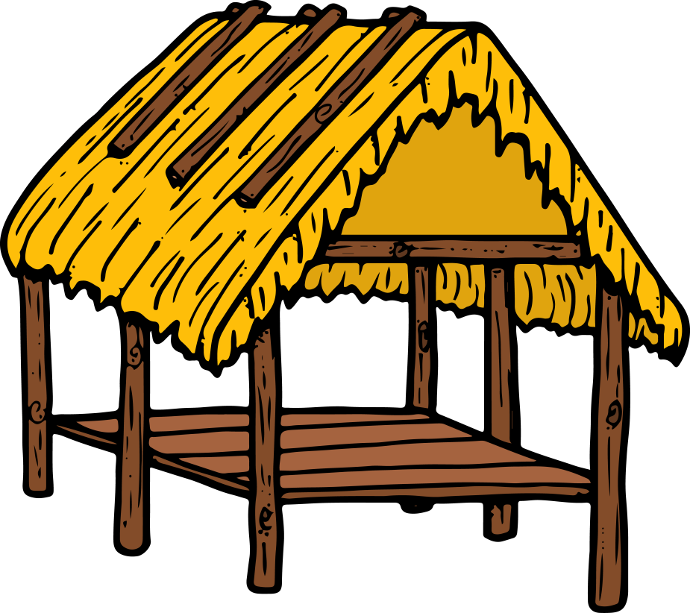
Shelter
Chickees (open house on stilts)
Wigwams
© Erin Kathryn 2015

Slide 7
Name: _____________________________________________ Date: ____________________
Seminole Notes
climate/region | food | clothing | shelter
© Erin Kathryn 2015

Slide 8
Name: _____________________________________________ Date: ____________________
Seminole Notes – Answer Key
climate/region | food | clothing | shelter
Southeast Present-day Florida Hot and humid weather | Gathered nuts, berries, and roots Corn, beans, and squash Hunted wild game and turkey | Thing clothing made out of grass Breechcl-oths and moccasins | Chickees (open house on stilts) Wigwams
© Erin Kathryn 2015

