Slide 1
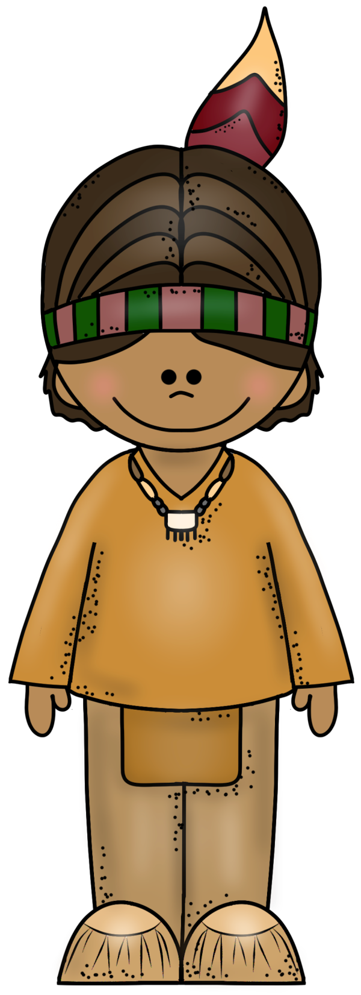
NEZ PERCE
tribe
PowerPoint
&
Notes
© Erin Kathryn 2015

Slide 2
Climate & Region
Plateau Region (Great Basin)
Plateau - Raised, flat-surfaced areas bounded on one or more sides by cliffs or steep slopes
Present-day Idaho, Oregon, and Washington
Area west of the Rocky Mountains
Experienced all four seasons
© Erin Kathryn 2015

Slide 3
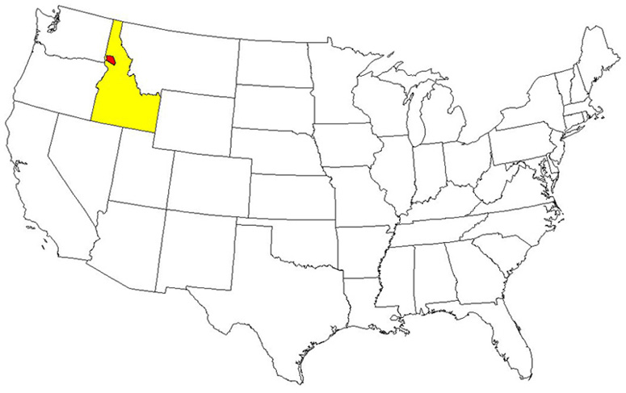
© Erin Kathryn 2015

Slide 4
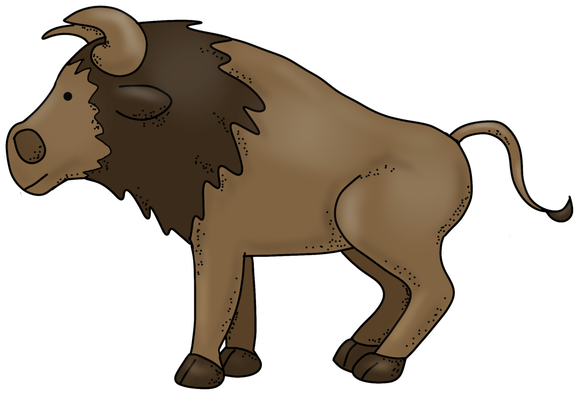
Food
Berries, roots, and nuts
Salmon
Elk, deer, bison, and buffalo
© Erin Kathryn 2015

Slide 5
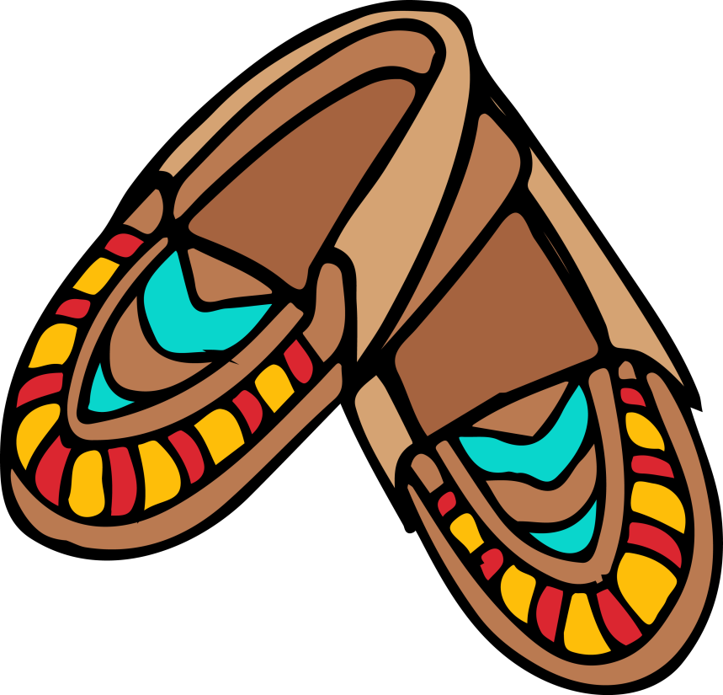
Clothing
Clothes made out of animal skin
Breechcloths
Moccasins
© Erin Kathryn 2015

Slide 6
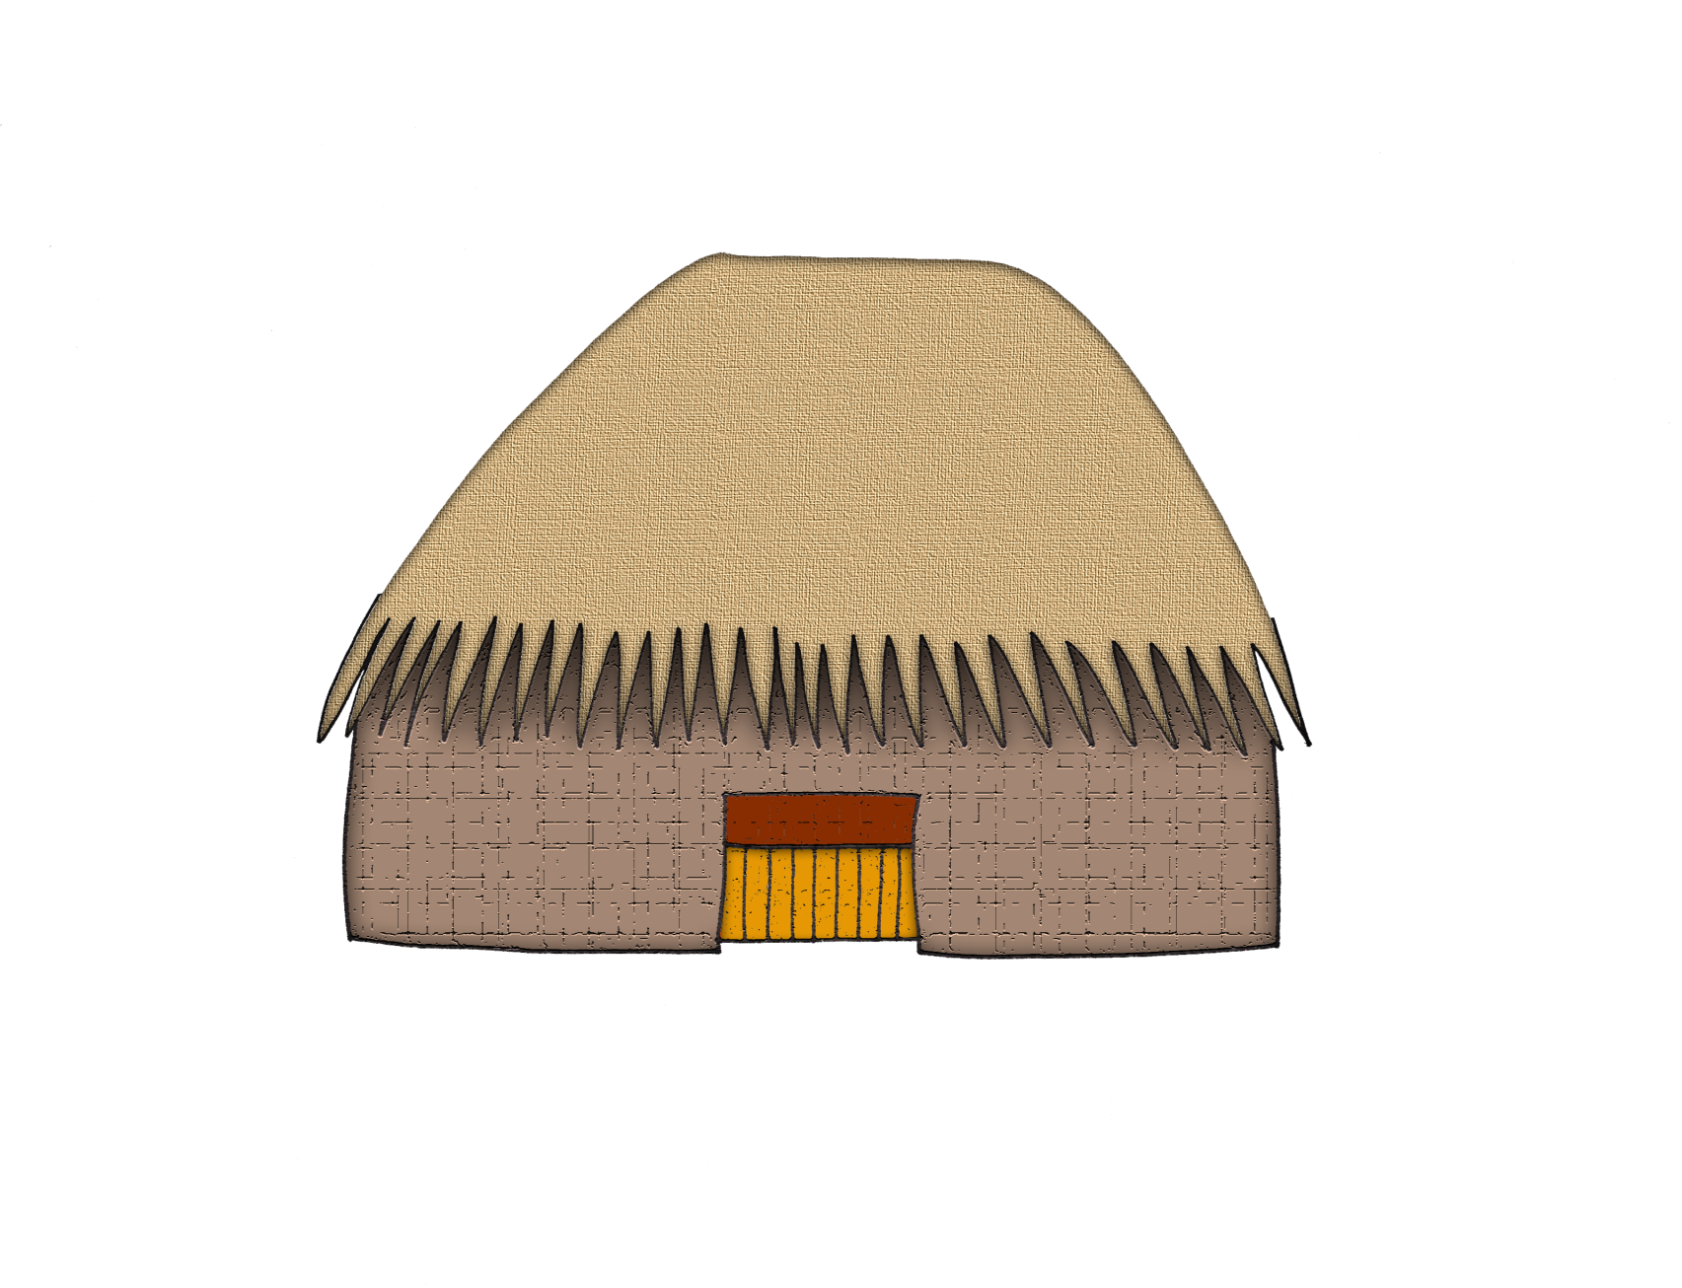
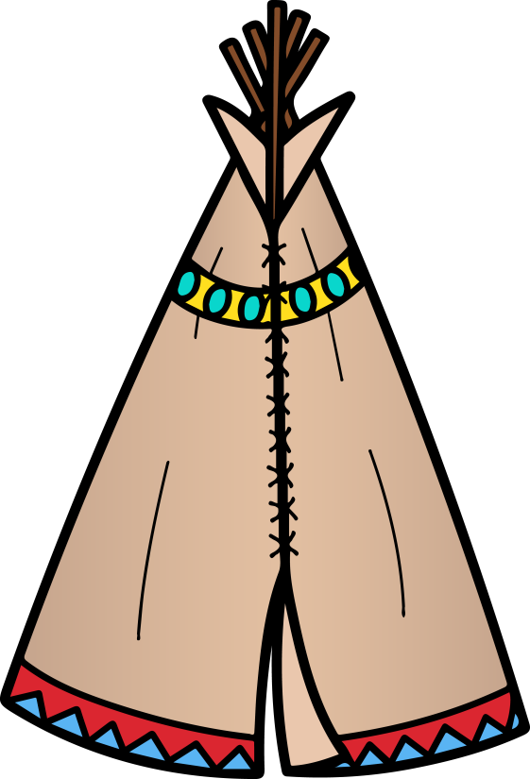
Shelter
Earth lodges
Tipis
© Erin Kathryn 2015

Slide 7
Name: _____________________________________________ Date: ____________________
Nez Perce Notes
climate/region | food | clothing | shelter
© Erin Kathryn 2015

Slide 8
Name: _____________________________________________ Date: ____________________
Nez Perce Notes – Answer Key
climate/region | food | clothing | shelter
Plateau Region (Great Basin) Present-day Idaho, Oregon, and Washington Area west of the Rocky Mountains Experienced all four seasons | Berries, roots, and nuts Salmon Elk, deer, bison, and buffalo | clothes out of animal skin breechcloths moccasins | Earth lodges tipis
© Erin Kathryn 2015

