Slide 1
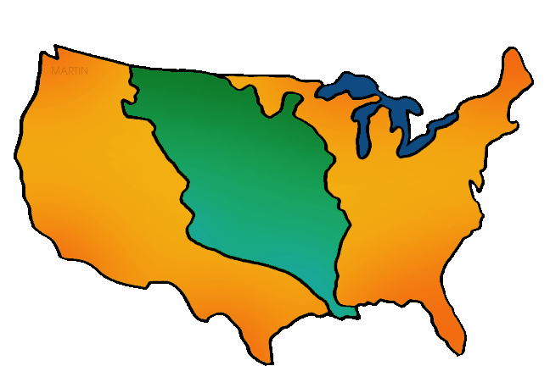
Louisiana
Purchase
PowerPoint & Notes
© Erin Kathryn 2014

Slide 2
Louisiana
Louisiana was the large area west of the Mississippi River.
1762 – Louisiana was given to Spain after the French & Indian War
1800 – France took control of Louisiana
© Erin Kathryn 2014

Slide 3
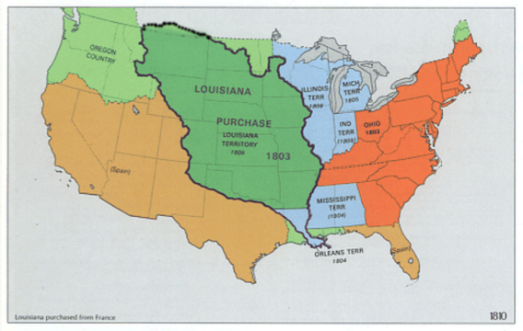
New Orleans
The largest port in Louisiana was the city of New Orleans.
American farmers worried that the French would no longer allow them to use the port in New Orleans.
© Erin Kathryn 2014

Slide 4
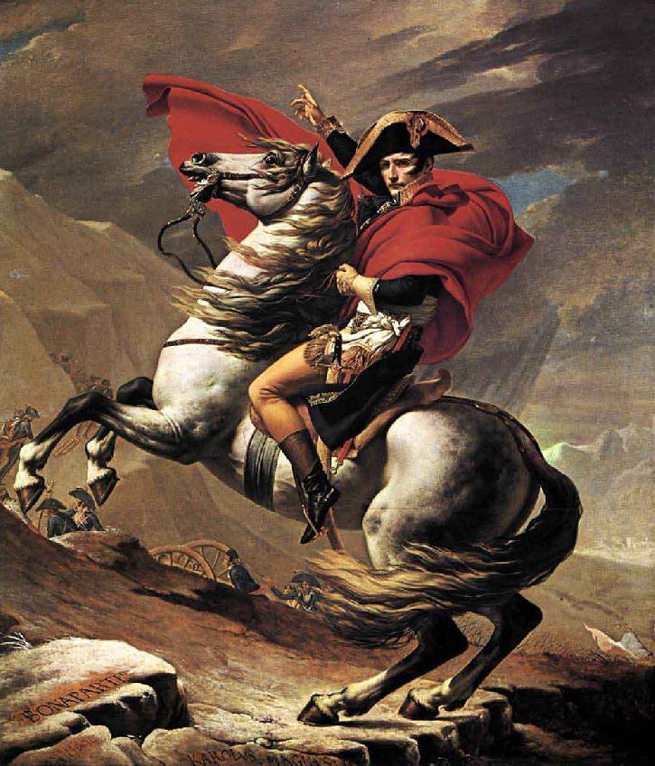
Napoleon Bonaparte
In 1803, Thomas Jefferson, the United States President, sent representatives to France.
The United States wanted French ruler, Napoleon Bonaparte, to agree that the U.S. could trade using the port in New Orleans.
© Erin Kathryn 2014

Slide 5
Land For Sale
The French offered to sell Louisiana to the United States because France needed money for the war against Great Britain.
Thomas Jefferson wanted this large piece of land for the United States, so he bought it.
© Erin Kathryn 2014

Slide 6
Louisiana Purchase
Napoleon sold the Louisiana Territory to the United States for $15 million dollars in 1803.
The Louisiana Purchase doubled the size of the United States. It added about 828,000 square miles to the country.
© Erin Kathryn 2014

Slide 7
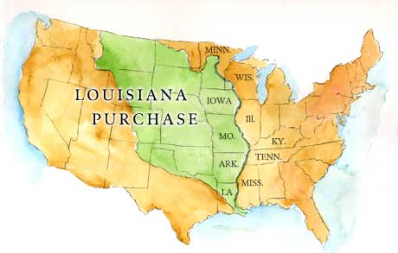
Louisiana Purchase
© Erin Kathryn 2014

