Slide 1
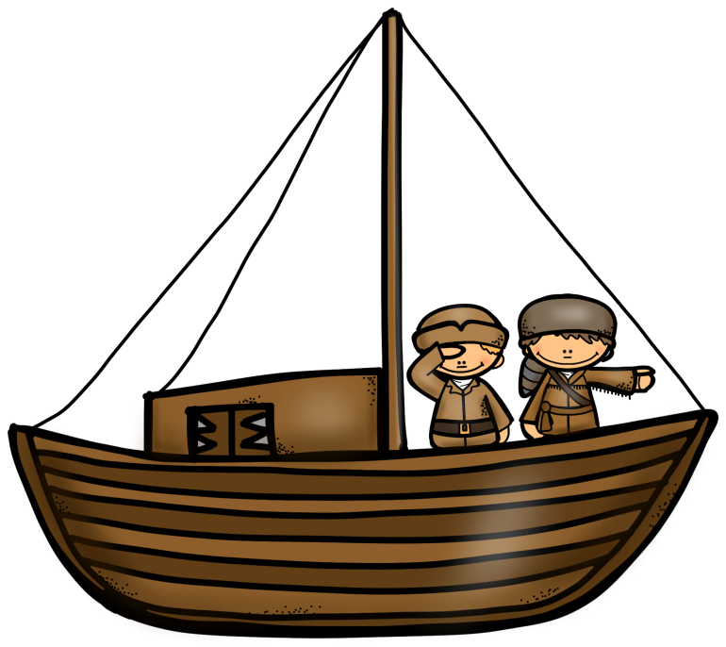
Lewis
&
Clark
PowerPoint & Notes
© Erin Kathryn 2015

Slide 2
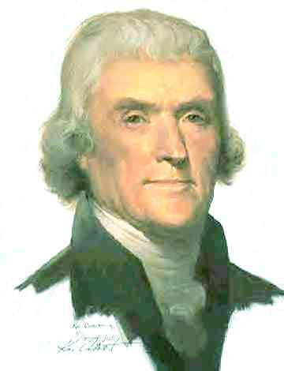
President
Jefferson
President Jefferson was always interested in science and nature.
President Jefferson sent an expedition to explore the west to find out more about the people, land, plants, and animals in the new found territory in the west.
© Erin Kathryn 2015

Slide 3
Lewis & Clark
President Jefferson chose Meriwether Lewis to lead the expedition.
Lewis invited his friend William Clark to help him.
Lewis and Clark set out from St. Louis in May 1804.
More than 30 people, mostly soldiers,
joined Lewis and Clark on their
journey.
© Erin Kathryn 2015

Slide 4
The Journey
Jefferson asked Lewis & Clark to do 3 things:
1. gather information about the landforms, plants, animals, and climates of the West
2. study the cultures of the west Indians
3. Explore the Missouri & Columbia rivers.
Jefferson hoped they would find a water
route to the Pacific Ocean.
© Erin Kathryn 2015

Slide 5
Exploring the West
The people traveling with Lewis & Clark were called the Corps of Discovery.
Corps – a team of people who work together
The group included Americans & French-Canadians.
Important People on the Trip:
York –enslaved African American
Sacagawea – Shoshone woman
© Erin Kathryn 2015

Slide 6
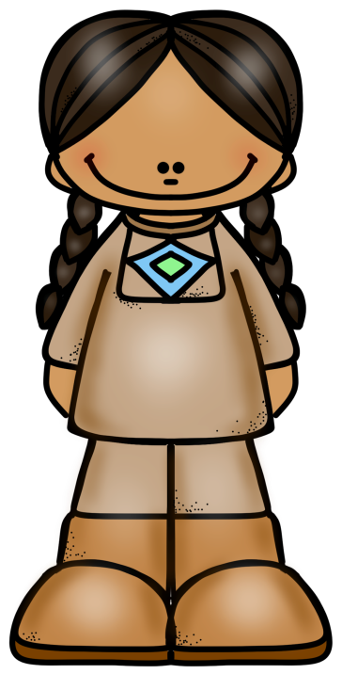
Sacagawea
Sacagawea was an interpreter, or someone who helps speakers of different languages understand each other.
Sacagawea was able to talk to some of the American Indians they met along the way and show that it was a peaceful
group.
© Erin Kathryn 2015

Slide 7
Sacagawea
Most importantly, Sacagawea helped Lewis & Clark trade for horses and supplies.
Without the horses, the journey west probably would have failed.
© Erin Kathryn 2015

Slide 8
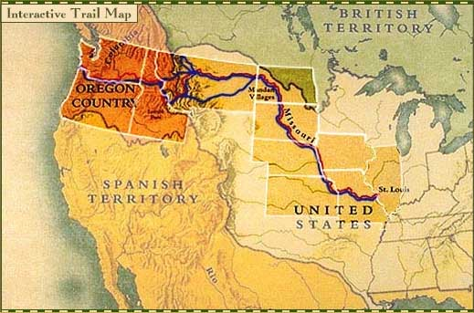
The Expedition
The Corps of Discovery traveled up the Missouri River, over the Rocky Mountains, and down the Columbia River to the Pacific Ocean.
The expedition returned to St. Louis in September 1806, after traveling
about 8,000 miles.
© Erin Kathryn 2015

Slide 9
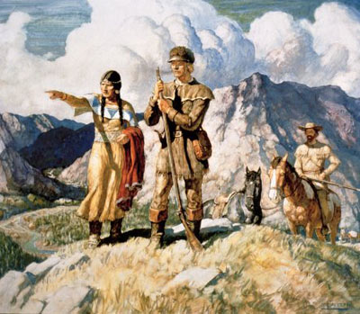
Pleasing the
President
Lewis and Clark completed the 3 tasks President Jefferson gave them.
They kept journals detailing the land they
saw and the people they met.
Although they learned that a direct water route to the Pacific Ocean did not exist, they proved that it was possible to cross the
continent through passes in the
Rocky Mountains.
© Erin Kathryn 2015

