Slide 1
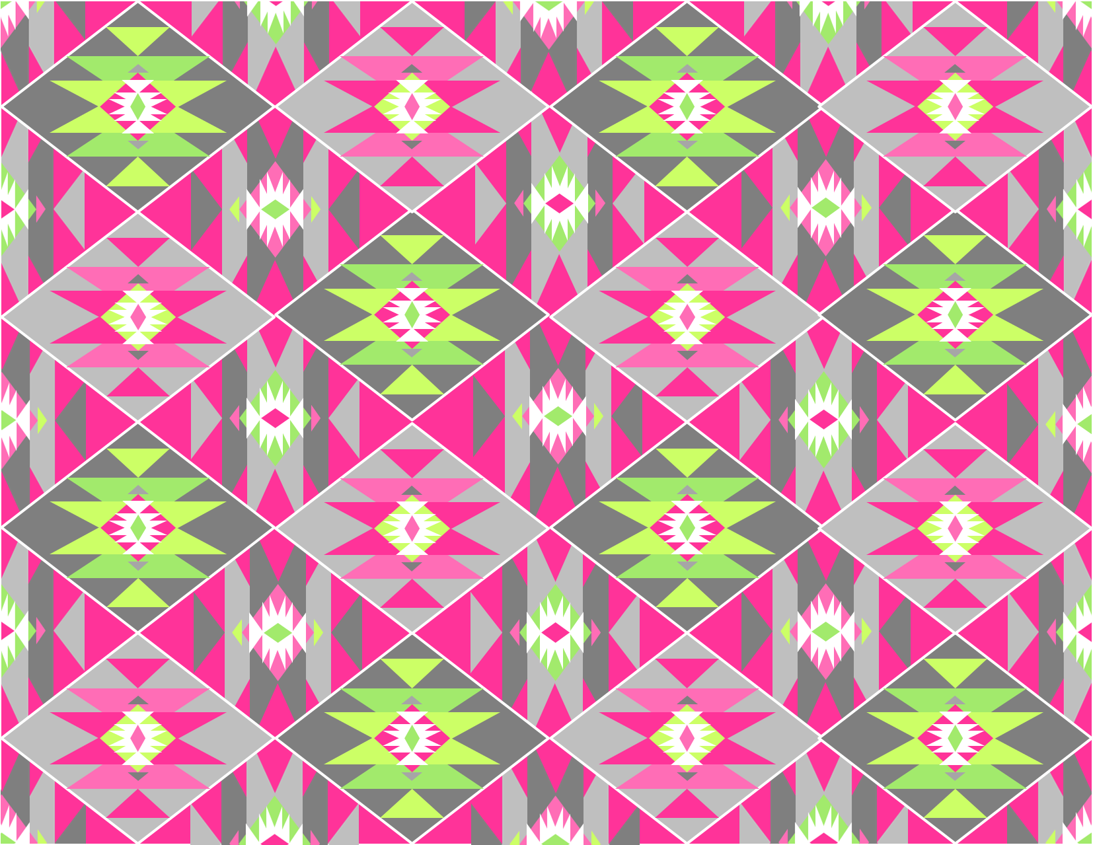
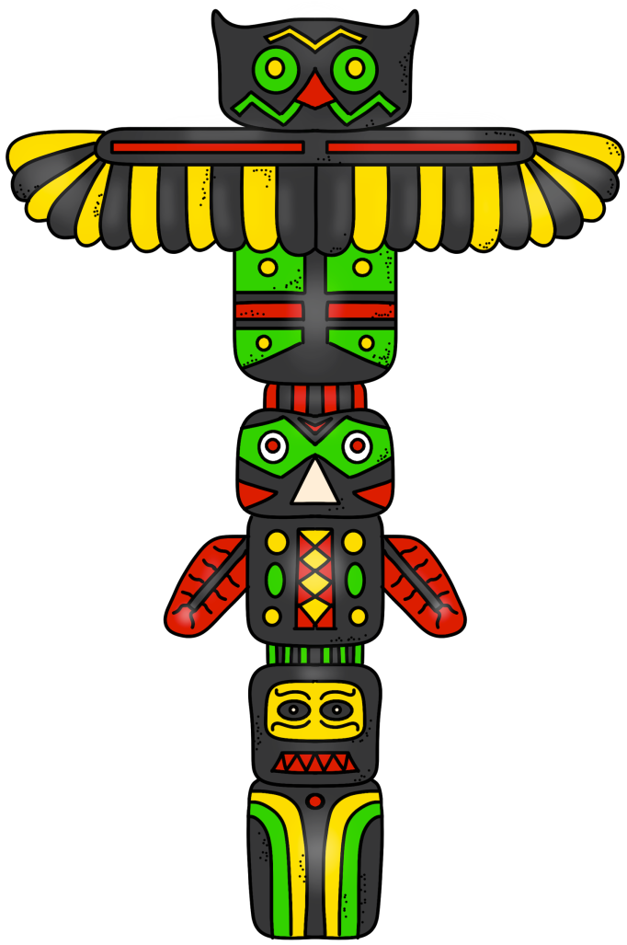
KWAKIUTL
tribe
PowerPoint
&
Notes
© Erin Kathryn 2015

Slide 2
Climate & Region
Northwest Coast (Canada and present-day Washington)
Had all four seasons
Close to oceans, forests, and lakes
© Erin Kathryn 2015

Slide 3
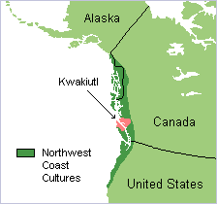
© Erin Kathryn 2015

Slide 4
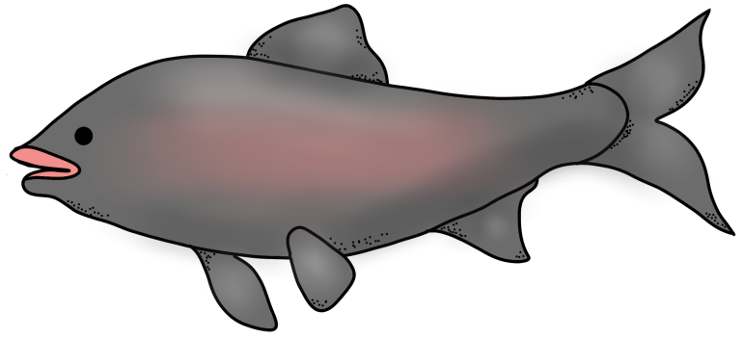
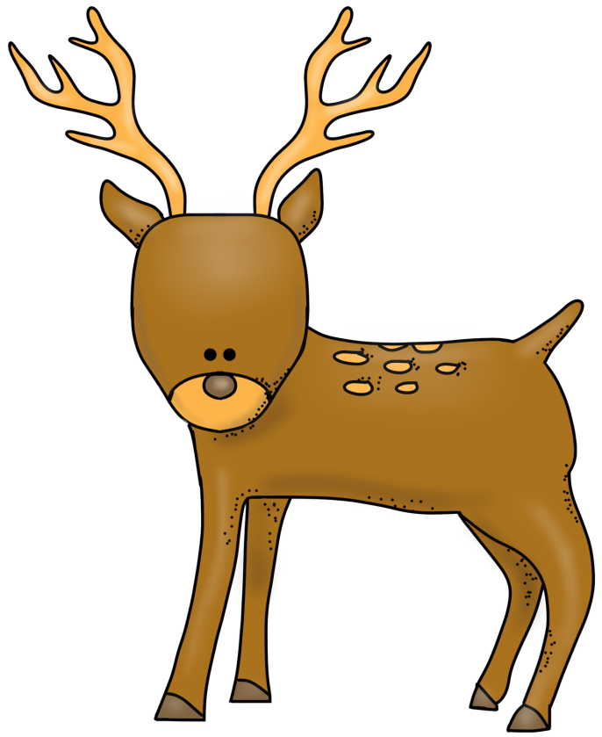
Food
fish, salmon, and shellfish
deer, caribou, and moose
berries and nuts
© Erin Kathryn 2015

Slide 5
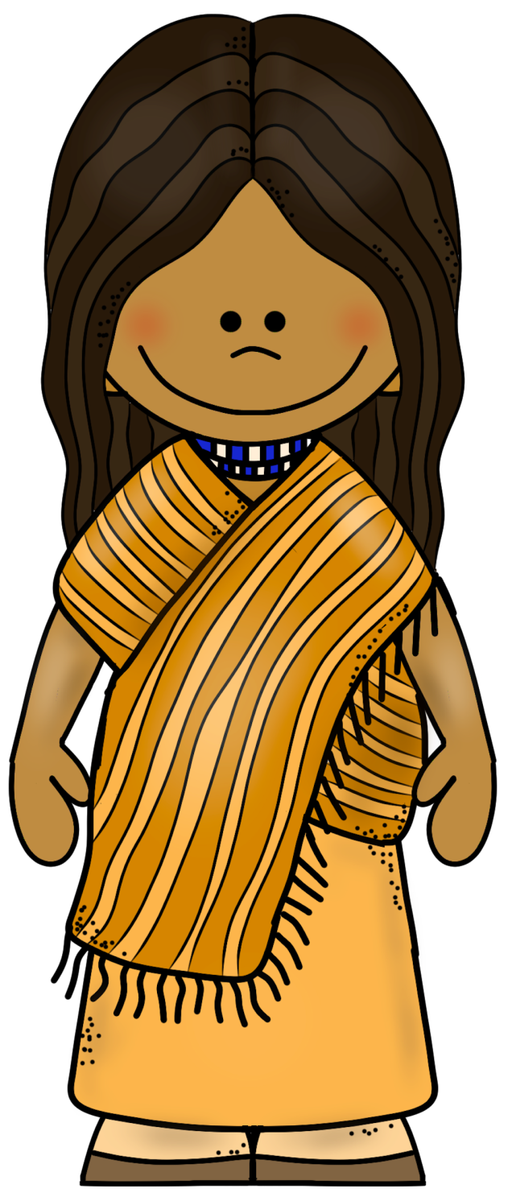
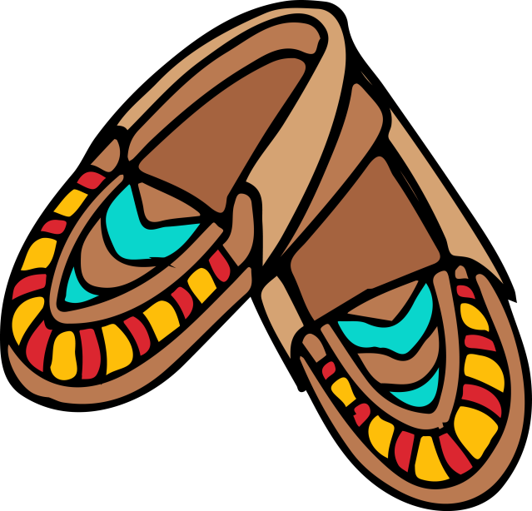
Clothing
Clothes made out of cedar bark
Moccasins
© Erin Kathryn 2015

Slide 6
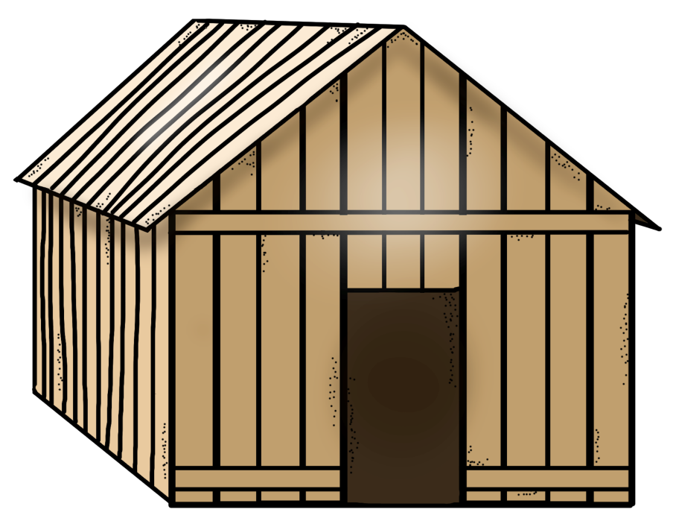
Shelter
Plank houses (long wooden houses made out of cedar trees)
© Erin Kathryn 2015

Slide 7
Name: _____________________________________________ Date: ____________________
Kwakiutl Notes
climate/region | food | clothing | shelter
© Erin Kathryn 2015

Slide 8
Name: _____________________________________________ Date: ____________________
Kwakiutl Notes – Answer Key
climate/region | food | clothing | shelter
Northwest Coast (Canada and present-day Washington) Had all four seasons Close to oceans, forests, and lakes | fish, salmon, and shellfish deer, caribou, and moose berries and nuts | Clothes made out of cedar bark Moccasins | Plank houses (long wooden houses made out of cedar trees)
© Erin Kathryn 2015

