Slide 1
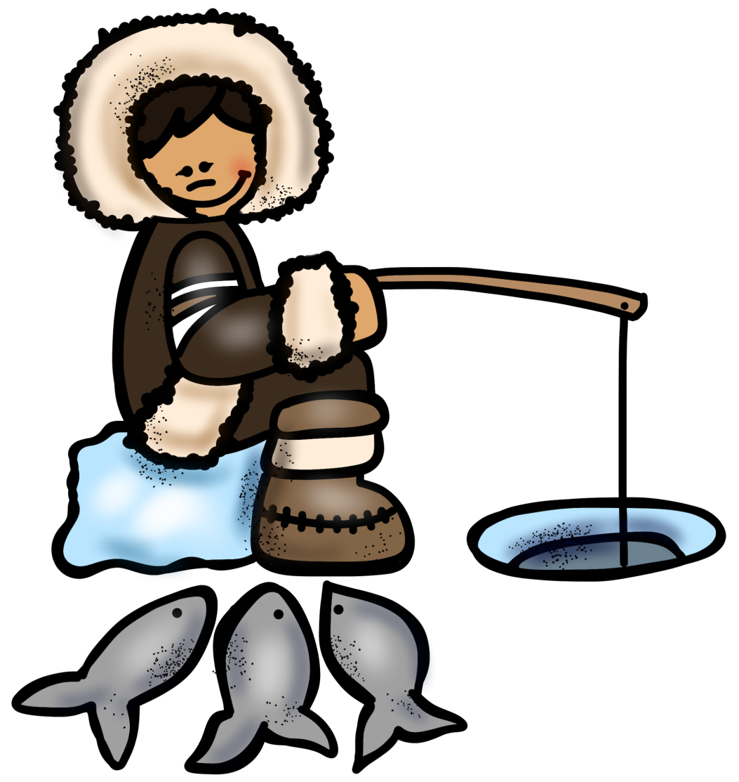
INUIT
TRIBE
PowerPoint
&
Notes
© Erin Kathryn 2015

Slide 2
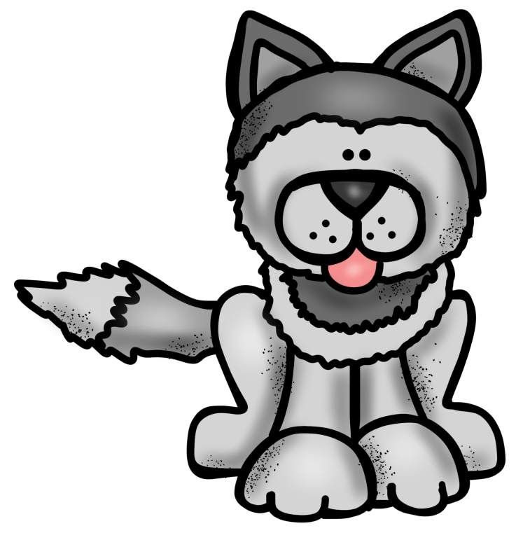
Climate & Region
Arctic tundra
Alaska, Canada, and Greenland
Very cold climate
© Erin Kathryn 2015

Slide 3
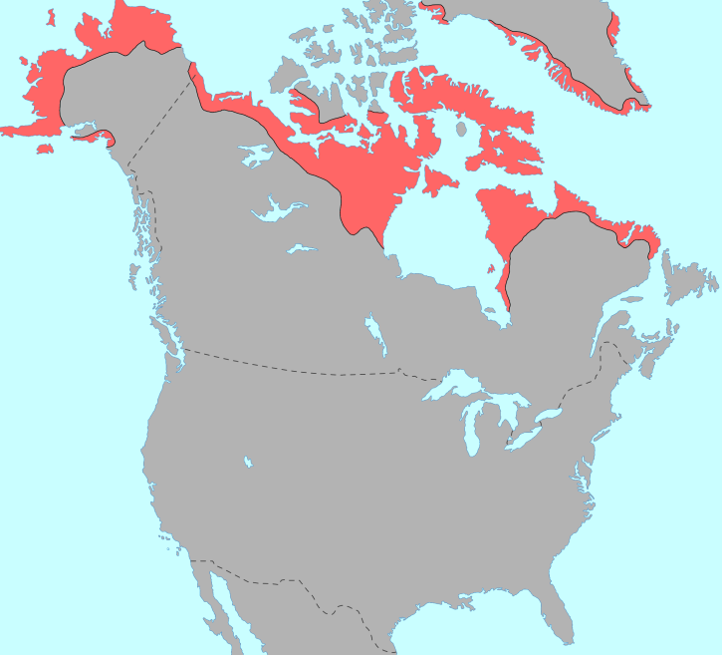
© Erin Kathryn 2015

Slide 4
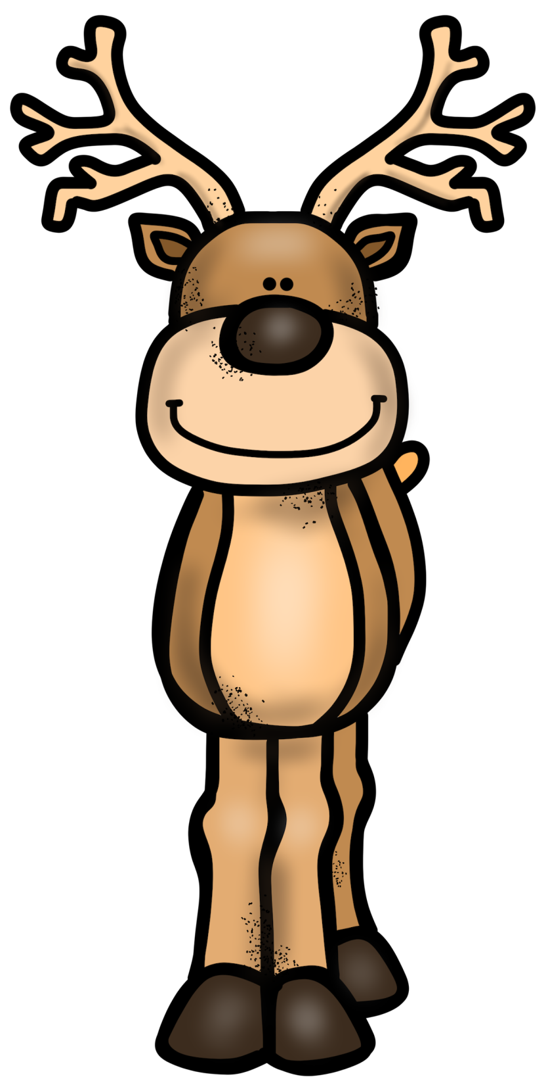
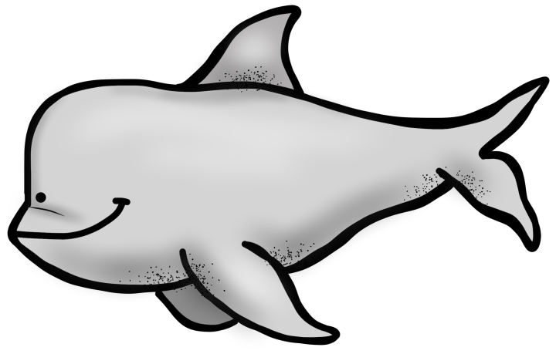
Food
Polar bear and caribou
Seals, salmon, whales, and fish
Gathered berries and nuts
© Erin Kathryn 2015

Slide 5
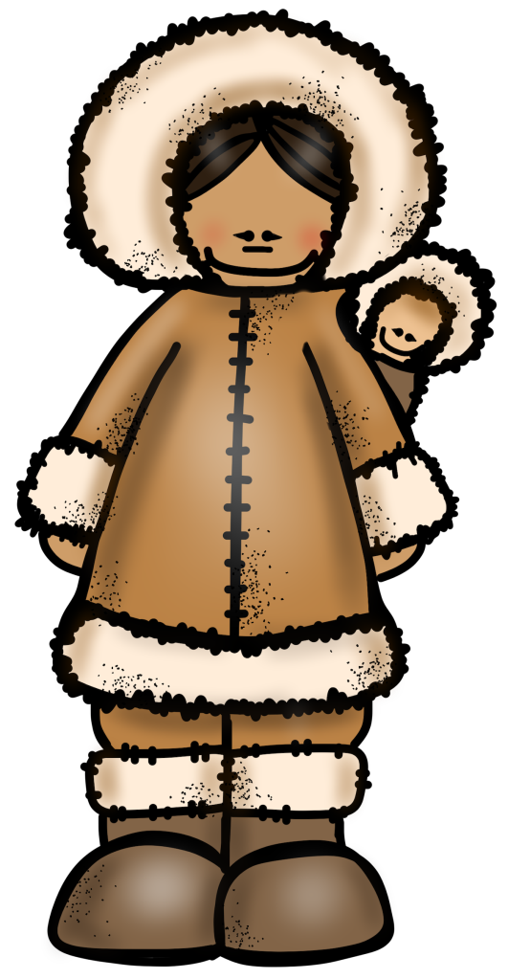
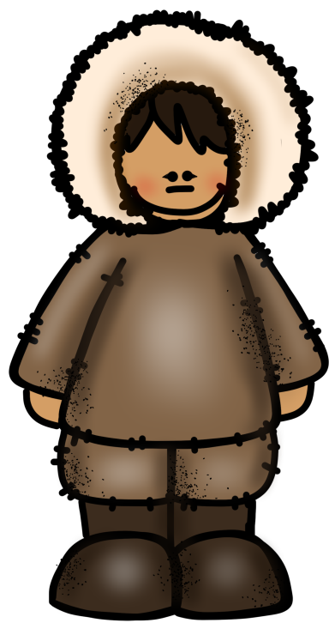
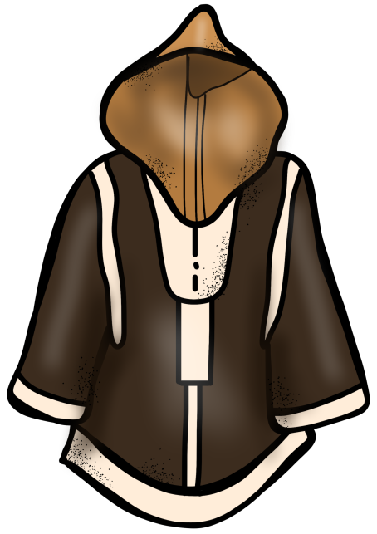
Clothing
Thick clothing made from animal fur and hides
© Erin Kathryn 2015

Slide 6
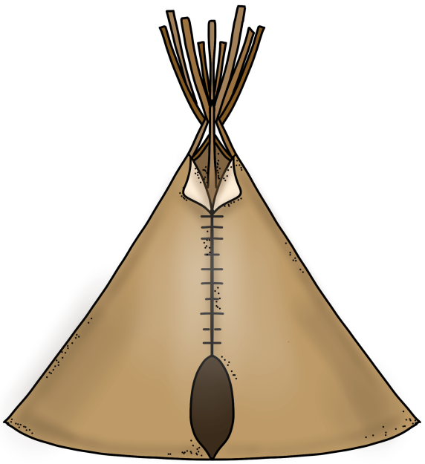
Shelter
Igloos (winter)
Tipis (summer)
© Erin Kathryn 2015

Slide 7
Name: _____________________________________________ Date: ____________________
Inuit Notes
climate/region | food | clothing | shelter
© Erin Kathryn 2015

Slide 8
Name: _____________________________________________ Date: ____________________
Inuit Notes – Answer Key
climate/region | food | clothing | shelter
Arctic tundra Alaska, Canada, and Greenland Very cold climate | Polar bear and caribou Seals, salmon, whales, and fish Gathered berries and nuts | Thick clothing made from animal fur and hides | Igloos (winter) Tipis (summer)
© Erin Kathryn 2015

