Slide 1
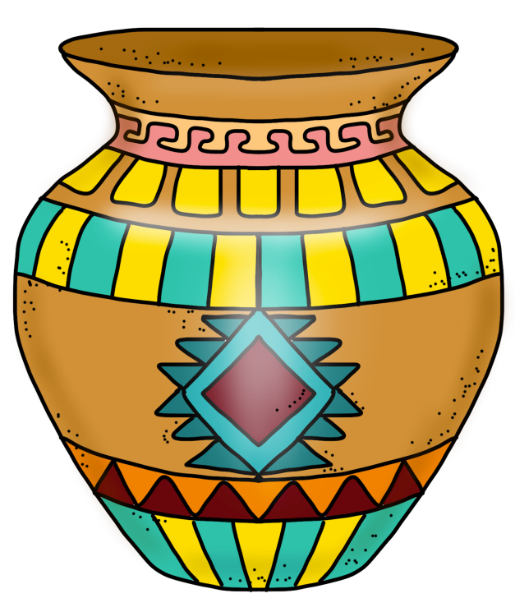
HOPI
tribe
PowerPoint
&
Notes
© Erin Kathryn 2015

Slide 2
Climate & Region
Southwest Desert
Present Day Arizona
Hot and Dry Climate with very little rain
© Erin Kathryn 2015

Slide 3
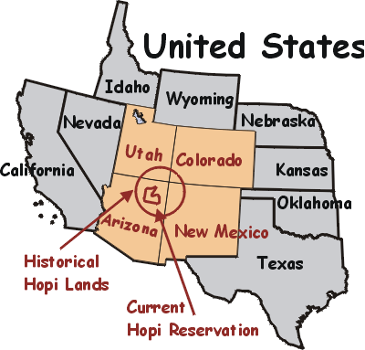
© Erin Kathryn 2015

Slide 4
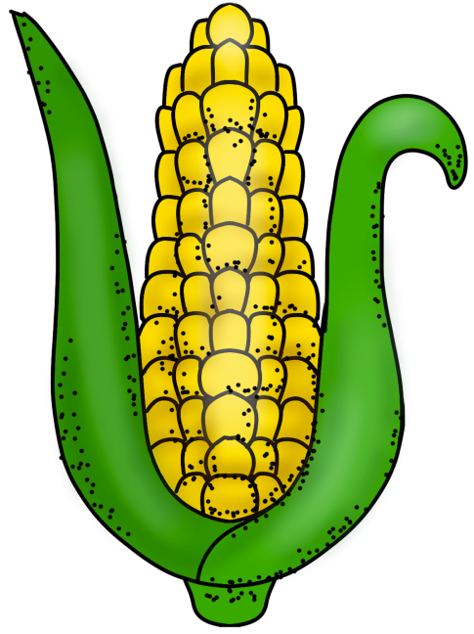
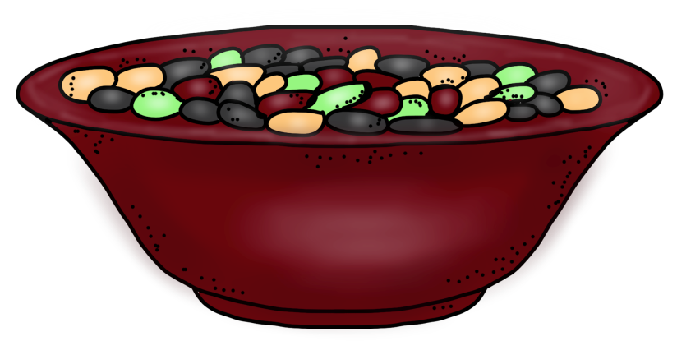
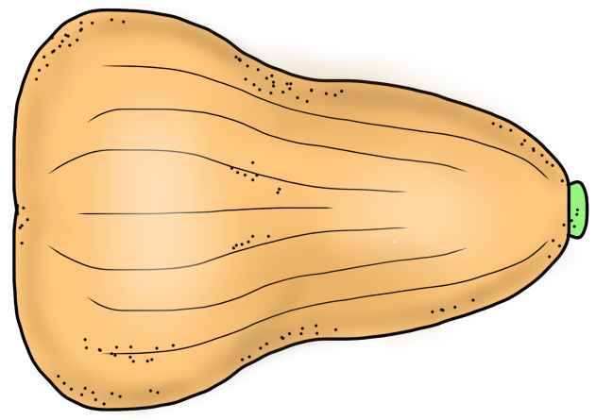
Food
Three Sisters – Corn, Beans, & Squash
Pumpkin
Bison
© Erin Kathryn 2015

Slide 5
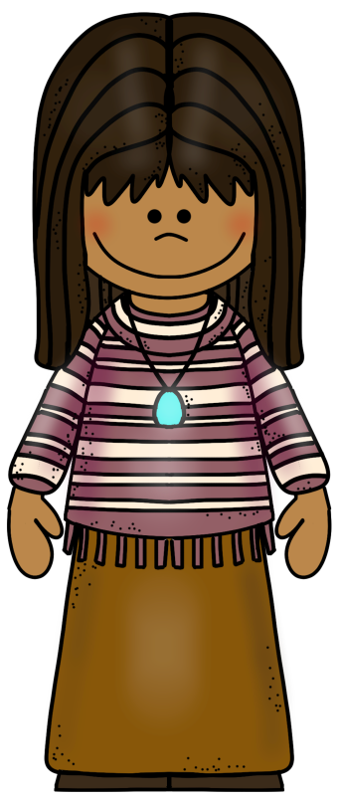
Clothing
Cool clothing made out of cotton
Breechcloths and moccasins
Women wore skirts and dresses
© Erin Kathryn 2015

Slide 6
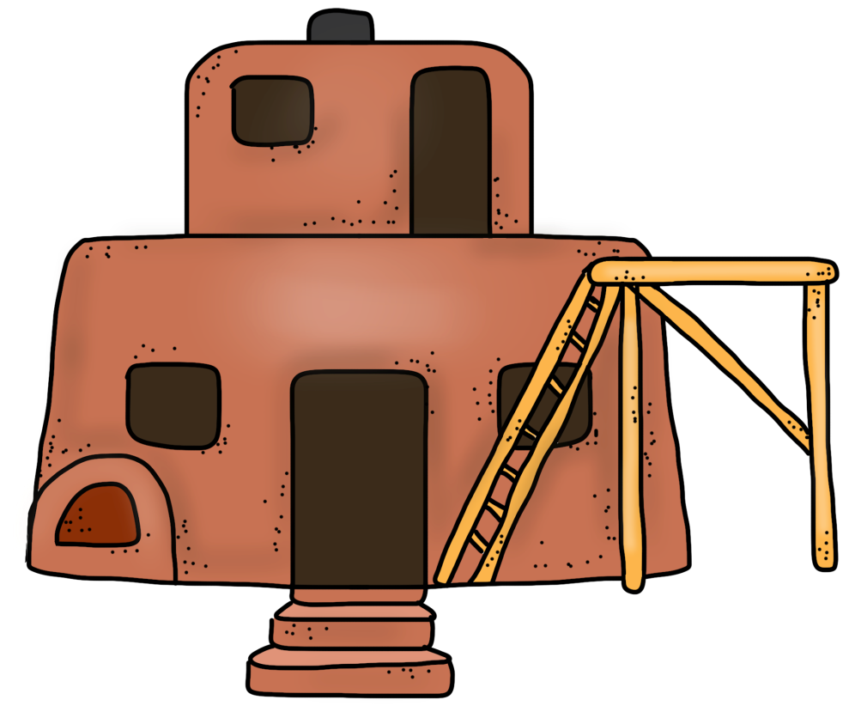
Shelter
Adobe Pueblos
Adobe bricks were made out of mud, stones, and straw
Pueblos used ladders to get in and out
© Erin Kathryn 2015

Slide 7
Name: _____________________________________________ Date: ____________________
Hopi Notes
climate/region | food | clothing | shelter
© Erin Kathryn 2015

Slide 8
Name: _____________________________________________ Date: ____________________
Hopi Notes – Answer Key
climate/region | food | clothing | shelter
Southwest Desert Present Day Arizona Hot and Dry Climate with very little rain | Three Sisters – Corn, Beans, & Squash Pumpkin Bison | Cool clothing made out of cotton Breechcloths and moccasins Women wore skirts and dresses | Adobe Pueblos Adobe bricks were made out of mud, stones, and straw Pueblos used ladders to get in and out
© Erin Kathryn 2015

