Slide 1
California
GoLd Rush
PowerPoint
&
Notes
© Erin Kathryn 2015

Slide 2
California
Before the 1700s – California Indians lived in villages where they hunted, fished, and gathered plants.
1821 – Mexico gained independence and California became a part of it. Mexican citizens built
ranches on old mission lands. American Indians were
forced to work on the ranches.
1848 – California joined the United States. Californios, or Mexican citizens in California,
became U.S. citizens.
© Erin Kathryn 2015

Slide 3
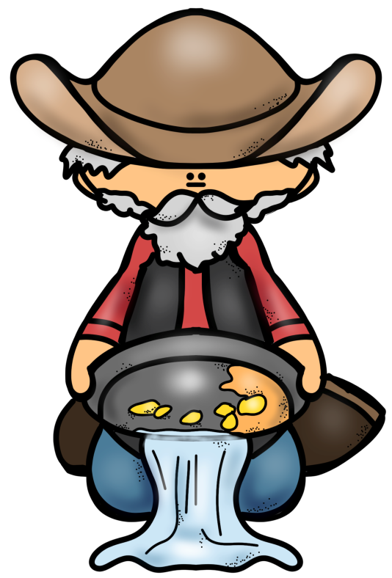
Forty-Niners
1849 – Gold was discovered in California.
Thousands of people from the United States, Mexico, China, Europe, and South America went to California in search for gold.
These people became known as
forty-niners.
A forty-niner was a miner who
went to California around 1849.
© Erin Kathryn 2015

Slide 4
The Rush For GoLd
This period of time was called the California Gold Rush.
More than 250,000 people went to California.
A gold rush takes place when many people rush to the same area to look for gold.
© Erin Kathryn 2015

Slide 5
BoomTowns
Boomtowns, or a town whose population grows very quickly, sprang up all around the gold mines.
Merchants and traders in boomtowns sold food, supplies, and clothing to the miners.
Banks and inns were opened and newspapers were published.
© Erin Kathryn 2015

Slide 6
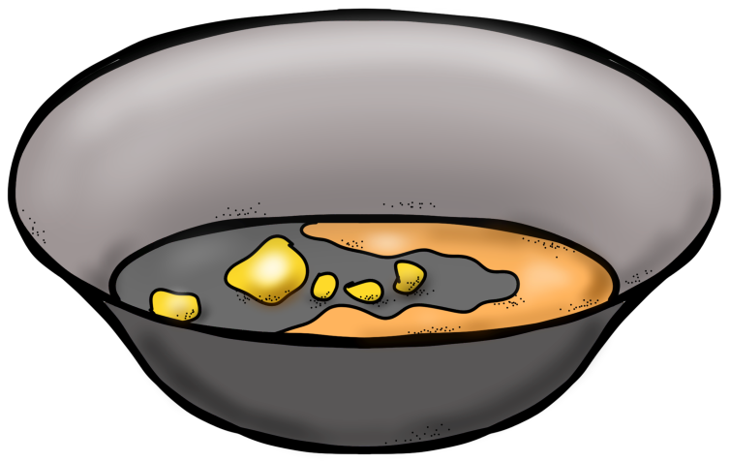
SuppLieS
The forty-niners needed supplies, such as a mining pan, a shovel, and a pick for mining.
The store owners and merchants selling the supplies often became more wealthy than the miners. They were able to sell items at very high prices and the miners were willing to pay.
© Erin Kathryn 2015

Slide 7
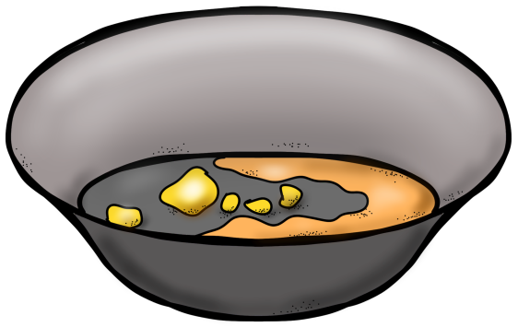
After the Rush
The California Gold Rush lasted about five years.
Most miners did not find gold.
Some forty-niners went home, but
thousands stayed in California.
The gold rush changed California.
Many California Indians were killed by miners
and farmers.
Newcomers forced the natives
off their land.
© Erin Kathryn 2015

Slide 8
After the Rush
Cities, such as San Francisco, grew during the California Gold Rush.
1950 – California had enough people to become a state.
The new state included American Indians and people from Mexico, China, South America, Europe, and other parts of the United States.
© Erin Kathryn 2015

