Slide 1
Articles
of
Confederation
© Erin Kathryn 2014

Slide 2
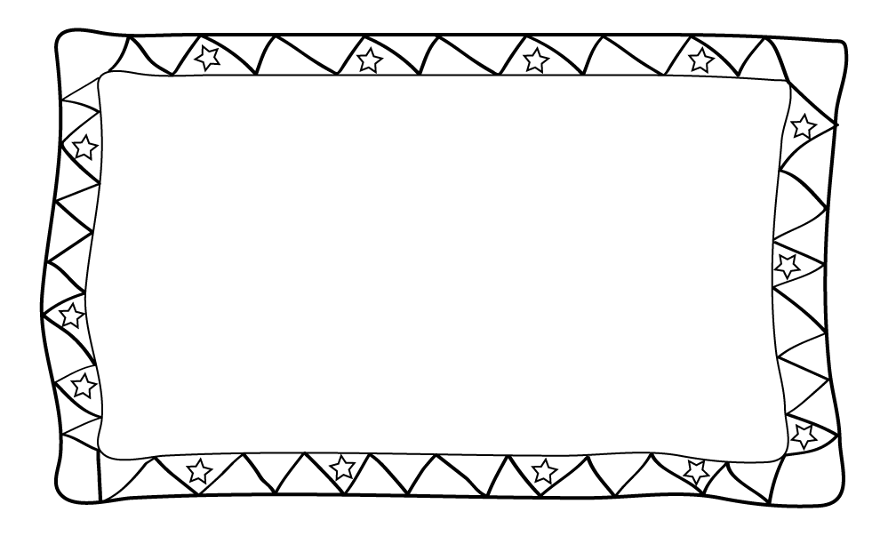
After becoming independent from
Britain, America needed a plan for
it’s own government.
The 13 newly formed states wanted to
be self-governed. Self-government
is when the people make laws for
themselves.
© Erin Kathryn 2014

Slide 3
Although the states did not want
a strong central government,
they needed to be united
as one country.
The Second Continental Congress
created a plan for the national
government called the
Articles of Confederation.
© Erin Kathryn 2014

Slide 4
States accepted the Articles
of Confederation in 1781.
The Articles of Confederation
made the national government
weak because it had less power
than each of the state’s
government.
© Erin Kathryn 2014

Slide 5
Pros
Congress could…
Declare war
Make peace treaties
Borrow money
Organize new territories
Establish postal service
Establish an army and navy
© Erin Kathryn 2014

Slide 6
Cons
Congress could not…
Regulate trade
Raise money with taxes
Force states to obey its laws
There was no executive (President)
or judicial (Supreme) branch of government.
© Erin Kathryn 2014

Slide 7
By 1786, it was clear that the Articles
of Confederation could not make
the states work together.
Why?
States were printing their own
money and deciding rules for trade.
Congress could not pay back its debts from
the War for Independence because they could not tax.
Congress asked states for money,
but they would not pay.
© Erin Kathryn 2014

Slide 8
Shay’s Rebellion
In 1786, a farmer named Daniel Shays led a group of farmers
in a protest against high state taxes. Shays wanted the state government to give them time to pay their debts. Shays and the farmers tried to capture weapons that belonged to the national government. The national government could not stop them because it did not have an army. State militia defeated the farmers.
Shays’s Rebellion showed that a weak national government could not keep order.
© Erin Kathryn 2014

Slide 9
In February 1787, Congress invited
the states to send delegates to
a meeting in Philadelphia to discuss
how to change the
Articles of Confederation.
© Erin Kathryn 2014

